Slide 1
Evolution on Purpose:
Why the Ultimate Success of CBS is Tied to Applied Evolution Science
Desarrollo del objetivo: Por qué el éxito final de la CBS está ligado a la ciencia de la evolución aplicada
Steven C. Hayes
University of Nevada

Slide 2
My Argument
Mi argumento
The reunification of contextual behavioral science and evolution science is important to the fulfillment of our purpose and our goal
La reunificación de la ciencia del comportamiento contextual y la ciencia de la evolución es necesaria para el cumplimiento de nuestro objetivo y nuestra meta
Notes:
There was no “black box” and no “tabula rasa”
The analysis of biological systems based on variation and selective retention.
My biases are more (b)VSR than BVSR (and the symbolic stream is a good reason why).

Slide 3
My Argument
Mi argumento
The impact and progress of CBS requires both developing its connection to evolution science, and redirecting evolution science itself
El impacto y el progreso de la CBS requiere tanto desarrollar su conexión con la ciencia de la evolución, como reorientar la ciencia de la evolución en sí
Notes:
There was no “black box” and no “tabula rasa”
The analysis of biological systems based on variation and selective retention.
My biases are more (b)VSR than BVSR (and the symbolic stream is a good reason why).

Slide 4
In Berlin, I Examined Six Areas
En Berlín, examiné seis áreas
Epigenetics and Modern Evolution
Psychotherapy
RFT
Psychopathology
Including the Group
Social Change
Epigenética y evolución moderna
Psicoterapia
RFT
Psicopatología
Incluyendo al grupo
Cambio social
Notes:
There was no “black box” and no “tabula rasa”
The analysis of biological systems based on variation and selective retention.
My biases are more (b)VSR than BVSR (and the symbolic stream is a good reason why).

Slide 5
Today I Will Examine One in More Detail
Hoy voy a examinar uno con más detalle
Process-based therapy (PBT) and psychopathology
La terapia basada en procesos (PBT) y psicopatología
Notes:
There was no “black box” and no “tabula rasa”
The analysis of biological systems based on variation and selective retention.
My biases are more (b)VSR than BVSR (and the symbolic stream is a good reason why).

Slide 6
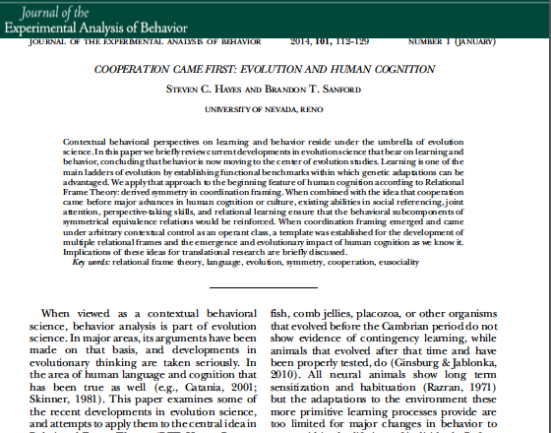
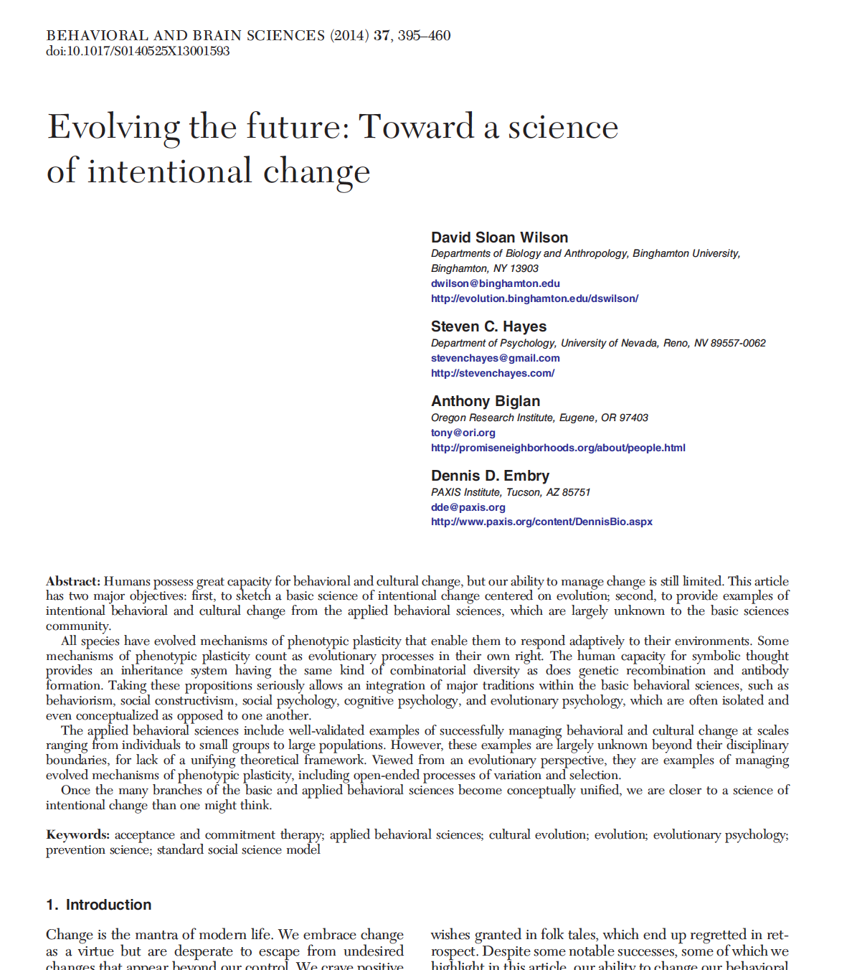
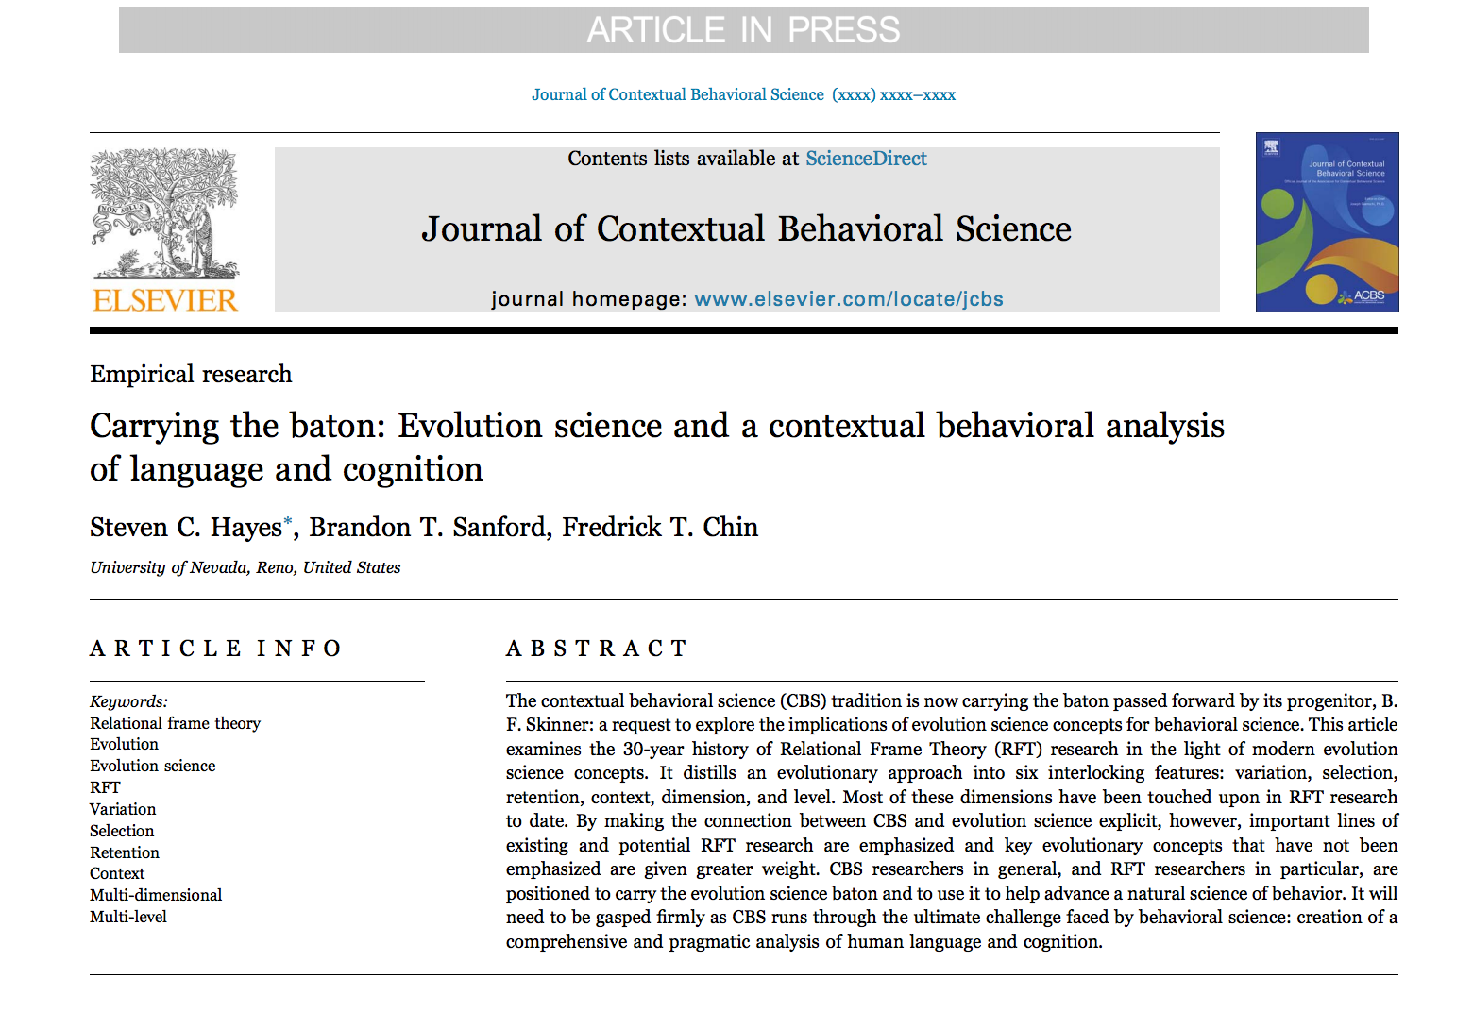
Notes:
There was no “black box” and no “tabula rasa”
The analysis of biological systems based on variation and selective retention.
My biases are more (b)VSR than BVSR (and the symbolic stream is a good reason why).

Slide 7
And Will Return to a Key Point:
Why Evolution Science Needs Us
Y volveré a un punto clave:Por qué la ciencia de la evolución nos necesita
Notes:
There was no “black box” and no “tabula rasa”
The analysis of biological systems based on variation and selective retention.
My biases are more (b)VSR than BVSR (and the symbolic stream is a good reason why).

Slide 8
Contextual Behavioral Psychology is a Kind of Evolutionary Psychology
La psicología contextual del comportamiento es un tipo de psicología evolutiva
“human behavior is the joint product of (i) the contingencies of survival responsible for the natural selection of the species and (ii) the contingencies of reinforcement responsible for the repertoires acquired by its members, including (iii) the special contingencies maintained by an evolved social environment. Ultimately, of course, it is all a matter of natural selection, since operant conditioning is an evolved process, of which cultural practices are special applications.” (Skinner, 1981, p. 502).
"El comportamiento humano es el producto conjunto de (i) las contingencias de supervivencia responsables de la selección natural de la especie y (ii) las contingencias de refuerzo responsables de los repertorios adquiridos por sus miembros, incluyendo (iii) las contingencias especiales mantenidas por un Entorno social evolucionado. En última instancia, por supuesto, todo es cuestión de selección natural, ya que el condicionamiento operante es un proceso evolucionado, del cual las prácticas culturales son aplicaciones especiales "
Notes:
There was no “black box” and no “tabula rasa”
The analysis of biological systems based on variation and selective retention.
My biases are more (b)VSR than BVSR (and the symbolic stream is a good reason why).

Slide 9
Skinner’s Last Sentence
Última conclusión de Skinner
“A better understanding of variation and selection will mean a more successful profession”
"Una mejor comprensión de la variación y la selección significará una profesión más exitosa"
Notes:
There was no “black box” and no “tabula rasa”
The analysis of biological systems based on variation and selective retention.
My biases are more (b)VSR than BVSR (and the symbolic stream is a good reason why).

Slide 10
This Was Rejected by Most Evolutionists
Esto fue rechazado por la mayoría de los evolucionistas
They argued that genes and memes are life and death – operants are not
Today we know that is a false dichotomy
Cells are systems for turning environment and behavior into biology
Argumentaron que los genes y los memes son vida y los operantes no lo son
Hoy sabemos que es una falsa dicotomía
Las células son sistemas para convertir el medio ambiente y el comportamiento en biología
Notes:
There was no “black box” and no “tabula rasa”
The analysis of biological systems based on variation and selective retention.
My biases are more (b)VSR than BVSR (and the symbolic stream is a good reason why).

Slide 11

Evolving on Purpose
Desarrollando el Objetivo
The processes I am pointing to with the term “evolution”
Los procesos que estoy señalando con el término "evolución"

Slide 12

Variation / Variación

Slide 13

Selection / Selección

Slide 14
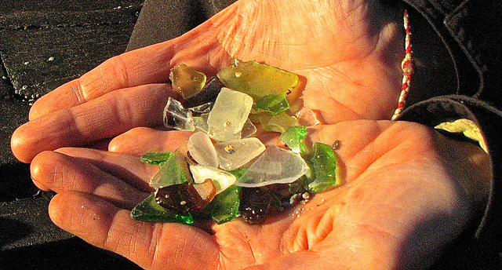
Retention / Retención

Slide 15
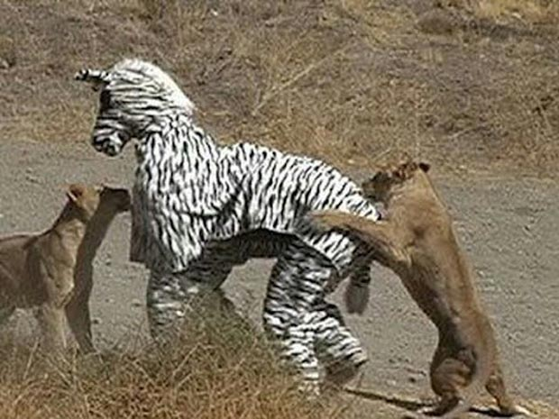
Context / Contexto

Slide 16
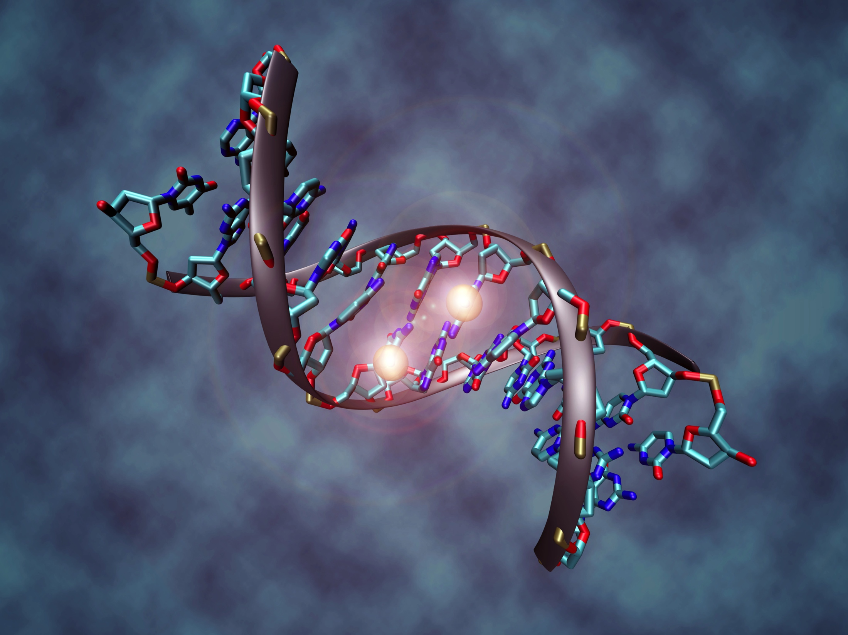
Dimension / Dimensión

Slide 17

Level / Nivel

Slide 18
Evolving on Purpose
Desarrollando el Objetivo
Variation / Variación
Selection / Selección
Retention / Retención
Context / Contexto
Dimension / Dimensión
Level / Nivel
Notes:
Gordon Paul’s 1966 Clinical Question

Slide 19

Process-Based Therapy (PBT)
and Psychopathology
La terapia basada en procesos (PBT) y psicopatología
Notes:
break

Slide 20







How do we best create a progressive
science of
mental and behavioral health

Slide 21
The Scientific Challenge
El Desafío Científico
For over 50 years there has been a consensus that evidence-based intervention needs ultimately to be based on a functional understanding of etiology, course, and response to treatment
Durante más de 50 años se ha llegado a un consenso en el sentido de que la intervención basada en la evidencia necesita en última instancia estar basada en una comprensión funcional de la etiología, el curso, y la respuesta al tratamiento
Notes:
Gordon Paul’s 1966 Clinical Question

Slide 22

The Era We’ve Lived Through
La era en la que hemos vivido

Slide 23
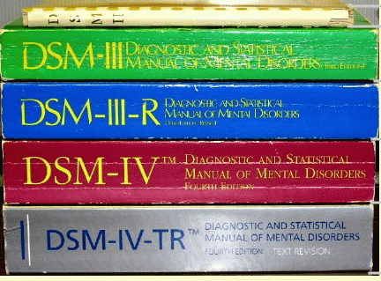

Notes:
HOW ARE THEY NAMED?

Slide 24
Acceptance and Commitment Therapy for Depression
Acceptance and Commitment Therapy
for Chronic Pain
Acceptance and Commitment Therapy for anxiety disorder
Acceptance and Commitment Therapy
for coping with psychosis
Applied Relaxation for Panic Disorder
Assertive Community Treatment for Schizophrenia
Behavior Therapy/Behavioral Activation for Depression
Behavioral Couple Therapy for Depression
Behavioral and Cognitive Behavioral Therapy for Chronic Low Back Pain
Behavioral Weight Loss Treatment for Obesity and Pediatric Overweight
Biofeedback-Based Treatments for Insomnia
Cognitive Adaptation Training for Schizophrenia
Cognitive Behavioral Analysis System of Psychotherapy for Depression
Cognitive Behavior Therapy for Insomnia
Cognitive Behavioral Therapy for Anorexia Nervosa
Cognitive Behavioral Therapy for Binge Eating Disorder
Cognitive Behavioral Therapy for Bulimia Nervosa
Cognitive and Behavioral Therapies for Generalized Anxiety Disorder
Cognitive Behavioral Therapy for Panic
Cognitive and Behavioral Therapies for Social Phobia/Public Speaking Anxiety
Cognitive Behavioral Therapy for Chronic Headache
Cognitive Behavioral Therapy for Schizophrenia
Cognitive Processing Therapy for Post-Traumatic Stress Disorder
Cognitive Remediation for Schizophrenia
Cognitive Therapy for Bipolar Disorder
Cognitive Therapy for Depression
Cognitive Therapy for Obsessive-Compulsive Disorder
Dialectical Behavior Therapy for Borderline Personality Disorder
Emotion-Focused Therapy for Depression
Exposure and Response Prevention for Obsessive-Compulsive Disorder
Exposure Therapies for Specific Phobias
Eye Movement Desensitization and Reprocessing for Post-Traumatic Stress Disorder
Family-Based Treatment for Anorexia Nervosa
Family-Based Treatment for Bulimia Nervosa
Family Focused Therapy for Bipolar Disorder
Family Psychoeducation for Schizophrenia
Healthy-Weight Program for Bulimia Nervosa
Interpersonal Therapy for Depression
Illness Management and Recovery for Schizophrenia
Interpersonal Psychotherapy for Binge Eating Disorder
Interpersonal Psychotherapy for Bulimia
Interpersonal and Social Rhythm Therapy for Bipolar Disorder
Multi-Component Cognitive Behavioral Therapy for Fibromyalgia
Multi-Component Cognitive Behavioral Therapy for Rheumatologic Pain
Paradoxical Intention for Insomnia
Problem-Solving Therapy for Depression
Prolonged Exposure for Post-Traumatic Stress Disorder
Psychoanalytic Therapy for Panic Disorder
Psychoeducation for Bipolar Disorder
Psychological Debriefing for Post-Traumatic Stress Disorder
Relaxation Training for Insomnia
Reminiscence/Life Review Therapy for Depression
Schema-Focused Therapy for Borderline Personality Disorder
Self-Management/Self-Control Therapy for Depression
Self-System Therapy for Depression
Short-Term Psychodynamic Therapy for Depression
Sleep Restriction Therapy for Insomnia
Social Learning/Token Economy Programs for Schizophrenia
Social Skills Training for Schizophrenia
Stimulus Control Therapy for Insomnia
Supported Employment for Schizophrenia
Systematic Care for Bipolar Disorder
Transference-Focused Therapy for Borderline Personality Disorder

Slide 25
Funding in the US
Financiación en E.E.U.U.
DSM is out
Practical effectiveness and process of change
Research Domain Criteria (RDoC)
  Negative Valence Systems, Positive Valence Systems, Cognitive Systems, Systems for Social Process, and Arousal & Regulatory Systems.
A major step forward, if we can use it ….
DSM está fuera
Efectividad práctica y proceso de cambio
Criterios del dominio de investigación (RDoC)
  Sistemas de Valencia Negativa, Sistemas de Valencia Positiva, Sistemas Cognitivos, Sistemas para Procesos Sociales, y Sistemas de Arousal y Regulatorios.
Un gran paso adelante, si podemos usarlo ....

Slide 26

"Un enfoque empírico, centrado en los principios, que es sensible al contexto y las funciones de los fenómenos psicológicos, no sólo su forma; Buscando la construcción de repertorios amplios, flexibles y eficaces sobre un enfoque eliminativo de los problemas estrechamente definidos, ... tanto para los clínicos como para los clientes "
“An empirical, principle-focused approach that is sensitive to the context and functions of psychological phenomena, not just their form; seeking the construction of broad, flexible and effective repertoires over an eliminative approach to narrowly defined problems, … for clinicians as well as clients.” (Hayes, 2004)

Slide 27

Changeable Processes Linked to Procedures
Procesos cambiantes vinculados a procedimientos

Slide 28
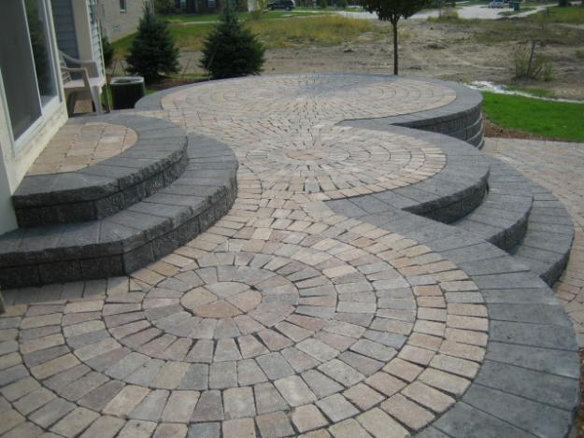

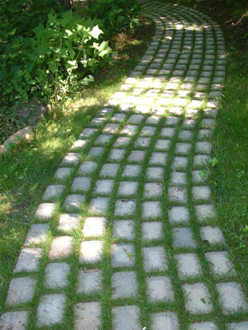
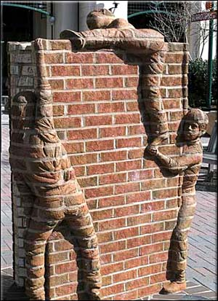
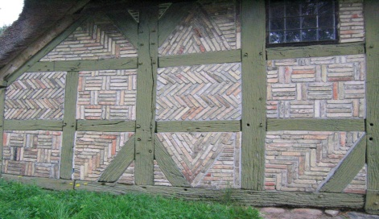


And Models That Help us Use Them
Y modelos que nos ayudan a usarlos

Slide 29
Process-Based Therapy (PBT)
La terapia basada en procesos (PBT)
Treatment based on the coherent application of changeable evidence-based processes linked to evidence-based procedures that ameliorate the problems and promote the prosperity of people
Tratamiento basado en la aplicación coherente de procesos cambiantes basados ​​en la evidencia vinculados a procedimientos basados ​​en evidencia que mejoran los problemas y promueven la prosperidad de las personas

Slide 30
What Kind of Processes?
¿Qué tipo de procesos?

Slide 31
What Kind of Processes?
¿Qué tipo de procesos?
With precision, scope, and depth
Con la precisión, alcance, y profundidad adecuados
Notes:
Reductionism and expansionism needed to be rejected

Slide 32
What Kind of Processes?
¿Qué tipo de procesos?
Broadly measured
  More than a specific measure
  Measurement across response modes and including theoretical features
Ampliamente medido
  Más que una medida específica
  Medición a través de los modos de respuesta e incluyendo características teóricas

Slide 33
What Kind of Processes?
¿Qué tipo de procesos?
Contextually embedded and changeable
  Functional sequences
  Not mere correlates
  Contextual hook to intervention
Contextualmente incorporado y cambiable
  Secuencias funcionales
  No son meros correlatos
  Gancho contextual a la intervención

Slide 34
What Kind of Processes?
¿Qué tipo de procesos?
Linked to basic science
  Entering the fabric of science
  How scope and depth are achieved
Vinculado a la ciencia básica
  Entrando en el tejido de la ciencia
  Cómo se alcanzan la dimensión y la profundidad

Slide 35
What Kind of Processes?
¿Qué tipo de procesos?
That mediate treatment outcomes
  Give practitioners focus and feedback
  Not a “cause”
Los que median los resultados del tratamiento
  Dar a los profesionales el enfoque y los comentarios
  No es una "causa"

Slide 36
What Kind of Processes?
¿Qué tipo de procesos?
With coherent moderators
  Common sense moderators rarely work
  Better theoretical models are needed
Con moderadores coherentes
  Los moderadores de sentido común rara vez trabajan
  Se necesitan mejores modelos teóricos

Slide 37
What Kind of Processes?
¿Qué tipo de procesos?
With adequate precision, scope, and depth
Broadly measured
Contextually embedded and changeable
Linked to basic science
That mediate treatment outcomes
With coherent moderators
Con precisión, dimensión y profundidad adecuados
Ampliamente medido
Contextualmente incorporado y cambiable
Vinculado a la ciencia básica
Que median los resultados del tratamiento
Con moderadores coherentes

Slide 38
We Need Models and Theories
Necesitamos modelos y teorías

Slide 39
What Kind of Models?
¿Qué tipo de modelos?

Slide 40
What Kind of Models?
¿Qué tipo de modelos?
Coherent
  There are already over 100 transdiagnostic processes and growing rapidly
  We need to simplify the cacophony
Coherente
  Ya hay más de 100 procesos de transdiagnóstico y aumenta rápidamente
  Necesitamos simplificar la cacofonía

Slide 41
What Kind of Models?
¿Qué tipo de modelos?
Broadly applicable and potent
  We need the 20% that does the 80%
Ampliamente aplicable y potente
  Necesitamos el 20% que hace el 80%

Slide 42
What Kind of Models?
¿Qué tipo de modelos?
Reasonably comprehensive
  A set of key processes covers a sufficient range of sub-issues with a client to serve as a reasonable guide to care
Razonablemente comprensivo
  Un conjunto de procesos clave cubre una gama suficiente de sub-temas con un cliente para servir como una guía razonable para el cuidado

Slide 43
What Kind of Models?
¿Qué tipo de modelos?
With known treatment utility
  Outcomes must be better applying the model than not
Con conocimiento de la utilidad del tratamiento
  Los resultados deben ser mejor aplicando el modelo que no

Slide 44
What Kind of Models?
¿Qué tipo de modelos?
Applicable to the individual in a form of functional analysis
  Nomothetic knowledge needs to tell us what is going on at the level of the individual
Aplicable al individuo en una forma de análisis funcional
  El conocimiento nomotético necesita decirnos lo que está sucediendo a nivel del individuo

Slide 45
What Kind of Models?
¿Qué tipo de modelos?
Coherent
Broadly applicable and potent
Reasonably comprehensive
With treatment utility
Applicable to the individual in a form of functional analysis
Coherente
Ampliamente aplicable y potente
Razonablemente comprensivo
Con utilidad de tratamiento
Aplicable al individuo en una forma de análisis funcional

Slide 46
To Do All of This We Need a
Successful Model of Models
Para hacer todo esto necesitamos unModelo de modelos exitoso

Slide 47
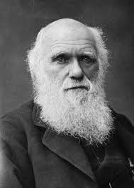
Evolution is the
Model of Models in
Every Other Area of Life Science.
Why Not Us?
La evolución es el modelo de los modelos en cualquier otra área de las Ciencias de la Vida.
¿Por qué no para nosotros?

Slide 48
Adequate Forms of PBT
Should Pass the
Model of Models Test

Slide 49

Acceptance and Commitment
Therapy (ACT) contains such
a model … but EvoS suggests how we can develop it further

Slide 50
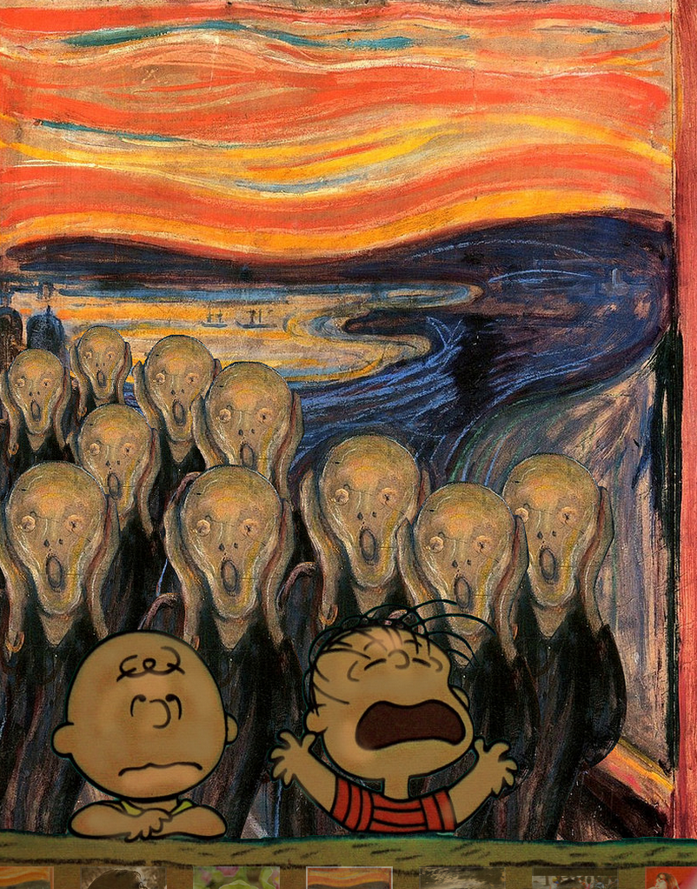
What are the Biggest
Enemies of Healthy
Variation and Selective Retention?
¿Cuáles son los mayores enemigos de la variación de salud y la retención selectiva?

Slide 51

#1: Avoidance / Elusión

Slide 52

#2: Excessive Rule Following /
Excesivo Seguimiento de las Reglas

Slide 53
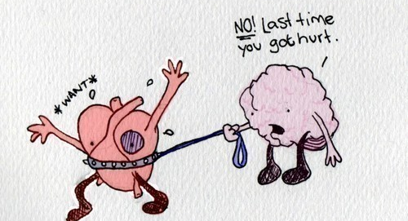
Or Both / O ambos

Slide 54
Open
An ACT Model of Treatment
Variation / Variación

Slide 55
An ACT Model of Treatment
Aware
Context /
Contexto

Slide 56
Actively Engaged
An ACT Model of Treatment
Selective Retention
Retención Selectiva

Slide 57
Most of the Third Wave is Based on Such Models

Slide 58
Variation / Variación
Methods | Treatment Method | Component Analysis | Process Evidence
MBCT | Open, accepting focus | -- | ✓
MCT | Detached mindfulness | -- | --
MI | Open questions | -- | ✓
BA | Undermining avoidance | -- | --
IBCT | Acceptance methods | -- | ✓
FAP | Acceptance modeled in the relationship | -- | ✓
DBT | Radical acceptance | -- | ✓
ACT | Acceptance and defusion exercises | ✓ | ✓
Notes:
Basic is responsible for applied; applied for basic. You must build the foundation … but
Often it is better to know what house will go on top of it
Thus often it works to start applied and go basic when the analysis requires it
BUT you need principles that are DIRECTLY modifiable and tested experimentally
And applied folks are more likely to do this
RFT itself is an example.
But let me give another example within RFT

Slide 59
Context / Contexto
Methods | Treatment Example | Component Analysis | Process Evidence
MBCT | Attentional training by following the breath | -- | ✓
MCT | Attention training techniques | ✓ | --
MI | -- | -- | --
BA | -- | -- | --
IBCT | -- | -- | --
FAP | Focus on present-moment awareness | -- | ✓
DBT | Attentional flexibility and control | -- | --
ACT | Observer self and perspective taking | ✓ | ✓
Notes:
Basic is responsible for applied; applied for basic. You must build the foundation … but
Often it is better to know what house will go on top of it
Thus often it works to start applied and go basic when the analysis requires it
BUT you need principles that are DIRECTLY modifiable and tested experimentally
And applied folks are more likely to do this
RFT itself is an example.
But let me give another example within RFT

Slide 60
Retención Selectiva
Methods | Treatment Example | Component Analysis | Process Evidence
MBCT | -- | -- | --
MCT | Exposure | ✓ | --
MI | Exploration of motives | -- | ✓
BA | Scheduling events | -- | ✓
IBCT | Behavioral homework | -- | ✓
FAP | Behavioral homework | -- | --
DBT | Skills training | ✓ | ✓
ACT | Values work | ✓ | ✓
Notes:
Basic is responsible for applied; applied for basic. You must build the foundation … but
Often it is better to know what house will go on top of it
Thus often it works to start applied and go basic when the analysis requires it
BUT you need principles that are DIRECTLY modifiable and tested experimentally
And applied folks are more likely to do this
RFT itself is an example.
But let me give another example within RFT

Slide 61
What About Data From the
Entire Field?
Are We Already Creating the
Bones of Such Models Just by
What the Mediational Results Tell Us?

Slide 62
What About the Literature at Large?
¿Qué pasa con la literatura en general?
PsychLit Journal publications: 2004 – 2017
Search terms
  “Mediation”
  “Randomized”
  Psychotherapy, therapy, cognitive therapy, etc
Publicaciones de la revista en PsychLit: 2004 – 2017
Términos de búsqueda “Mediación“ "Aleatorizado“
Psicoterapia, terapia, terapia cognitiva, etc.

Slide 63
What About the Literature at Large?
¿Qué pasa con la literatura en general?
Examined over 200 studies. For example, “mediation, randomized, therapy” yielded 62 references, of which 50 were retained
Se examinaron más de 200 estudios. Por ejemplo, "mediación, terapia aleatoria, terapia" produjo 62 referencias, de las cuales 50 fueron retenidas

Slide 64
Strategy / Estrategia
Eliminated:
  Unsuccessful studies
  Mere correlational evidence
  Outcomes as mediators
  Treatment markers
  Review articles
Eliminado:
  Estudios fallidos
  Mera evidencia correlacional
  Resultados como mediadores
  Marcadores de tratamiento
  Revisar articulos

Slide 65
Variation / Variación
Psychological flexibility
Experiential avoidance
Ruminative brooding
Non-reactivity
Self-acceptance
Acceptance
Cognitive defusion
Emotion-focused coping
Believability of negative thoughts
Emotion-regulation (DERS)
Reductions in avoidance
Reductions in worry
Flexibilidad psicológica
Elusión experiencial
Pensamiento rumiativo
No reactividad
Auto-aceptación
Aceptación
Difusión cognitiva
Enfrentamiento emocional
Credibilidad de los pensamientos negativos
Regulación emocional
Reducciones de la invalidación
Reducciones en la preocupación

Slide 66
Variation / Variación
Non-attachment
Self-compassion
Reduced fear avoidance beliefs
Reduced anxiety sensitivity
Reduced symptom catastrophizing
Reappraisal frequency
Negative representations
Mood reactivity
Fear of intense emotions
Irrational beliefs
Panic appraisal
Reduced behavioral coping
Reduced resistance
No adjunto
Autocompasión
Reducción de las creencias de evitar el miedo
Reducción de la sensibilidad a la ansiedad
Reducción de síntomas de catástrofes
Frecuencia de reevaluación
Representaciones negativas
Reactividad del estado de ánimo
Miedo a las emociones intensas
Creencias irracionales
Evaluación de pánico
Reducción de la conducta
Resistencia reducida

Slide 67
Contact with Context
Contacto con Contexto
Acting with awareness
Mindfulness
Attentional flexibility
Reductions in self-focused attention
Observing
Attention focusing
Attention shifting
Inhibitory control of attention
Reduced discrepancy between self report and objective measures
Actuar con conciencia
Atención plena
Flexibilidad de atención
Reducciones en la atención auto-enfocada
Observar
Atención enfocando
Desplazamiento de la atención
Control inhibitorio de la atención
Reducción de la discrepancia entre el autoinforme y las medidas objetivas

Slide 68
Selective Retention
Retención Selectiva
Behavioral engagement
Behavioral activation
Increased behavioral skills
Increased social reinforcement
Better conflict management skills
Improved self-efficacy
Compromiso conductual
Activación conductual
Aumento de las habilidades conductuales
Mayor refuerzo social
Mejores habilidades de gestión de conflictos
Mejora de la autoeficacia

Slide 69
Right Level / Nivel correcto
Feeling of family closeness and cohesion
Sense that someone cared
Working alliance / therapeutic alliance
Trust in others
Perceived social support
Sensación de cercanía y cohesión familiar
Sentir que le importa a alguien
Alianza de trabajo / alianza terapéutica
Confianza en los demás
Percibir apoyo social

Slide 70
Psychopathology
Psicopatología
Without intending to do so, the empirical literature itself is already focusing on sets of processes that fit with an evolutionary perspective as a model of models
Sin pretender hacerlo, la propia literatura empírica ya se centra en conjuntos de procesos que encajan con una perspectiva evolutiva como modelo de modelos

Slide 71
Psychopathology
Psicopatología
Psychopathology refers to a set of self-sustaining biopsychosocial processes that restrict healthy variation, selection, or retention, and/or sensitivity to context, dimensions, and levels: an evolutionary process that prevents positive behavioral development via normal evolutionary processes.
La psicopatología se refiere a un conjunto de procesos biopsicosociales autosuficientes que restringen la variación, selección o retención saludables, y / o sensibilidad al contexto, las dimensiones y los niveles: un proceso evolutivo que impide el desarrollo del comportamiento positivo a través de procesos evolutivos normales.

Slide 72
ACT
ACT is clearly a form of PBT.
ACT is not a technology. ACT is an intervention focused on the psychological flexibility model.
It passes the model of models test, but it is weakest on levels and dimensions
We can do better there by attending to the motivation inside inflexibility

Slide 80
Human Yearning
Belonging and connection
Meaning and purpose
Competence
Coherence
Orientation
Feeling

Slide 81
Using EvoS as a Guide
You can readily use this way of thinking to expand the focus of ACT work to better address levels and dimensions
Examples include the kinds of things in Mastering the Clinical Conversation, or compassion work, or FAP work, or all of the developments of which I am aware in RFT

Slide 82
Psychological Flexibility Model
Levels: socially scaling (e.g., compassion; relationship; couples, families, communities, organizations)
Dimensions
  It assumes all behavioral methods, especially exposure and skills development.
  Skill development needs to include cognitive flexibility and tracking contingencies
We can do improve our model by attending to the yearning / need / motivation inside inflexibility

Slide 83
So, If You Focus on the
Psychological Flexibility Model Must You Call it ACT?
No
Branding can help in dissemination
If it hurts, do something else
But be careful of gumbo

Slide 84
Why Evolution Science Need Us and Why We Have to Help
Clean Up the Mess
Learning is the ladder of evolution, and an analysis of symbolic behavior is needed
Evolution is culturally contaminated which hurts us
The best way to decontaminate is to create a powerful, useful, and safe form of applied evolution science
Notes:
There was no “black box” and no “tabula rasa”
The analysis of biological systems based on variation and selective retention.
My biases are more (b)VSR than BVSR (and the symbolic stream is a good reason why).

Slide 85

Contaminated Evolution
“The point is, ladies and gentleman, that ‘greed’ – for lack of a better word – is good. Greed is right. Greed works. Greed clarifies, cuts through and captures the essence of the evolutionary spirit.” Gordon Gekko
Notes:
There was no “black box” and no “tabula rasa”
The analysis of biological systems based on variation and selective retention.
My biases are more (b)VSR than BVSR (and the symbolic stream is a good reason why).

Slide 86
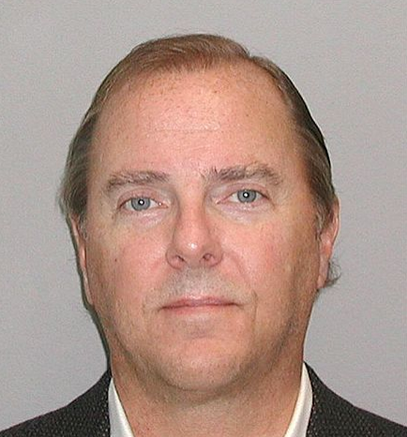
Contaminated Evolution
Jeffrey Skilling
His Performance review system brought us Enron
Rank and Yank – 15% of the employees must be ranked in the bottom.
Two week notices
Same as Harvard Business School
Dawkins: Selfish Gene
Notes:
There was no “black box” and no “tabula rasa”
The analysis of biological systems based on variation and selective retention.
My biases are more (b)VSR than BVSR (and the symbolic stream is a good reason why).

Slide 87

Contaminated Evolution
Eugenics
Racism
Hostility to religion
Notes:
There was no “black box” and no “tabula rasa”
The analysis of biological systems based on variation and selective retention.
My biases are more (b)VSR than BVSR (and the symbolic stream is a good reason why).

Slide 88
Why Evolution Science Need Us and Why We Have to Help
Clean Up the Mess
The best way to decontaminate is to create a powerful, useful, and safe form of applied evolution science
Notes:
There was no “black box” and no “tabula rasa”
The analysis of biological systems based on variation and selective retention.
My biases are more (b)VSR than BVSR (and the symbolic stream is a good reason why).

Slide 89
Behavioral Psychology Faced This Too
Notes:
There was no “black box” and no “tabula rasa”
The analysis of biological systems based on variation and selective retention.
My biases are more (b)VSR than BVSR (and the symbolic stream is a good reason why).

Slide 90
Evolution and CBS
Our fate is bound together
We are developing evolutionarily sensible interventions (e.g., ACT, CFT, PROSOCIAL, The Nurture Effect, Good Behavior Game)
Reintegrating behavioral and evolution science to achieve a better world is our destiny
Let’s work together to see what we can accomplish
Notes:
There was no “black box” and no “tabula rasa”
The analysis of biological systems based on variation and selective retention.
My biases are more (b)VSR than BVSR (and the symbolic stream is a good reason why).

